Slide 1

Week 2: Problem Framing Step of PrOACT
Instructor: Brielle K Thompson
Course: NAT_R 8001 Decision Analysis for Research and Management of Natural Resources
Notes:
First 30 minutes = intro
Next 60 = slides
Final 30 = activity

Slide 2

Review of last week
Learned about how cognitive biases impact human decision making
Learned about system 1 and system 2 thinking
Discussed key assumptions of Decision analysis/Structured Decision Making (SDM)
Values focused thinking
Decomposes complex problems (PrOACT)
Provided a brief illustrative case study of SDM using the glen canyon dam as a case study

Slide 3
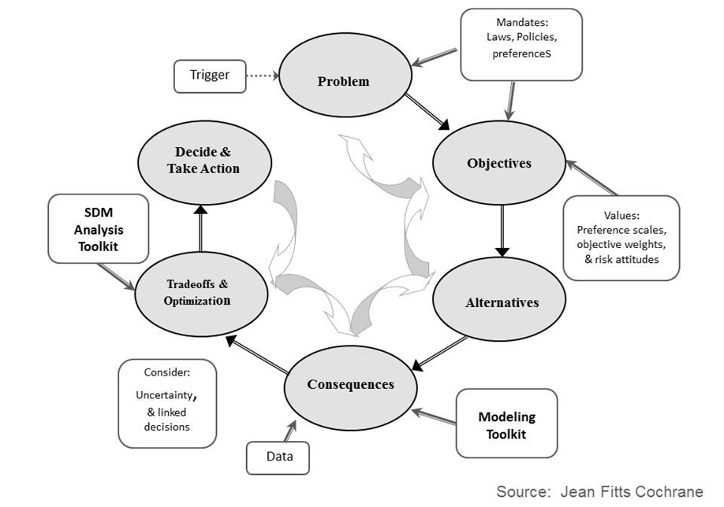

Slide 4
Common errors:
Decision makers naturally jump to thinking about alternatives
Alternative focused thinking
Narrow problem framing
Omission of important objectives
Developed by Justin Gude, Angela Romito, Mike Runge

Slide 5
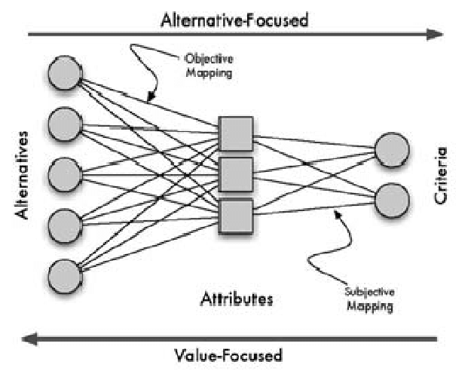
Aside: Values focused vs Alternatives focused thinking:
“Value-focused thinking involves starting at the best and working to make it a reality. Alternative-focused thinking is starting with what is readily available and taking the best of the lot” – Keeny 1992
In other words: value-focused thinking first decides what you want, then you figure out how to get there
Parnell & West 2008
Developed by Brielle Thompson

Slide 6
Common errors:
Decision makers naturally jump to thinking about alternatives
We assume the problem has defined itself. So, we don’t frame the problem or think about what we really want to achieve
We have relied on a study culture:
“A problem is identified … and … a study is launched to provide additional information. Why the study is needed, or how any new information will contribute to a better choice among management options, is rarely specified” (Gregory and Long 2012 Chapter 3)
Alternative focused thinking
Narrow problem framing
Omission of important objectives
Developed by Justin Gude, Angela Romito, Mike Runge, Brielle Thompson

Slide 7
Problem framing
First and most important task in SDM
Provides an a priori, explicit, and shared understanding of the problem
Making decisions is the problem
Sets bounds on the problem by identifying spatial, temporal, organizational, legal, and other relevant bounds
Incorrect problem framing means we are wasting effort solving the wrong problem
Deciding between a finite set of alternative courses of action should be the focus of problem solving (i.e., decision making).
Developed by Justin Gude, Angela Romito, Mike Runge

Slide 8

Problem framing analogy
Can be thought of as a “mission/vision/value statement” for a decision situation
Shutterstock
Developed by Brielle Thompson

Slide 9
“A good solution to a well-posed decision problem is almost always a smarter choice than an excellent solution to a poorly posed one.”
~ Hammond et al.

Slide 10
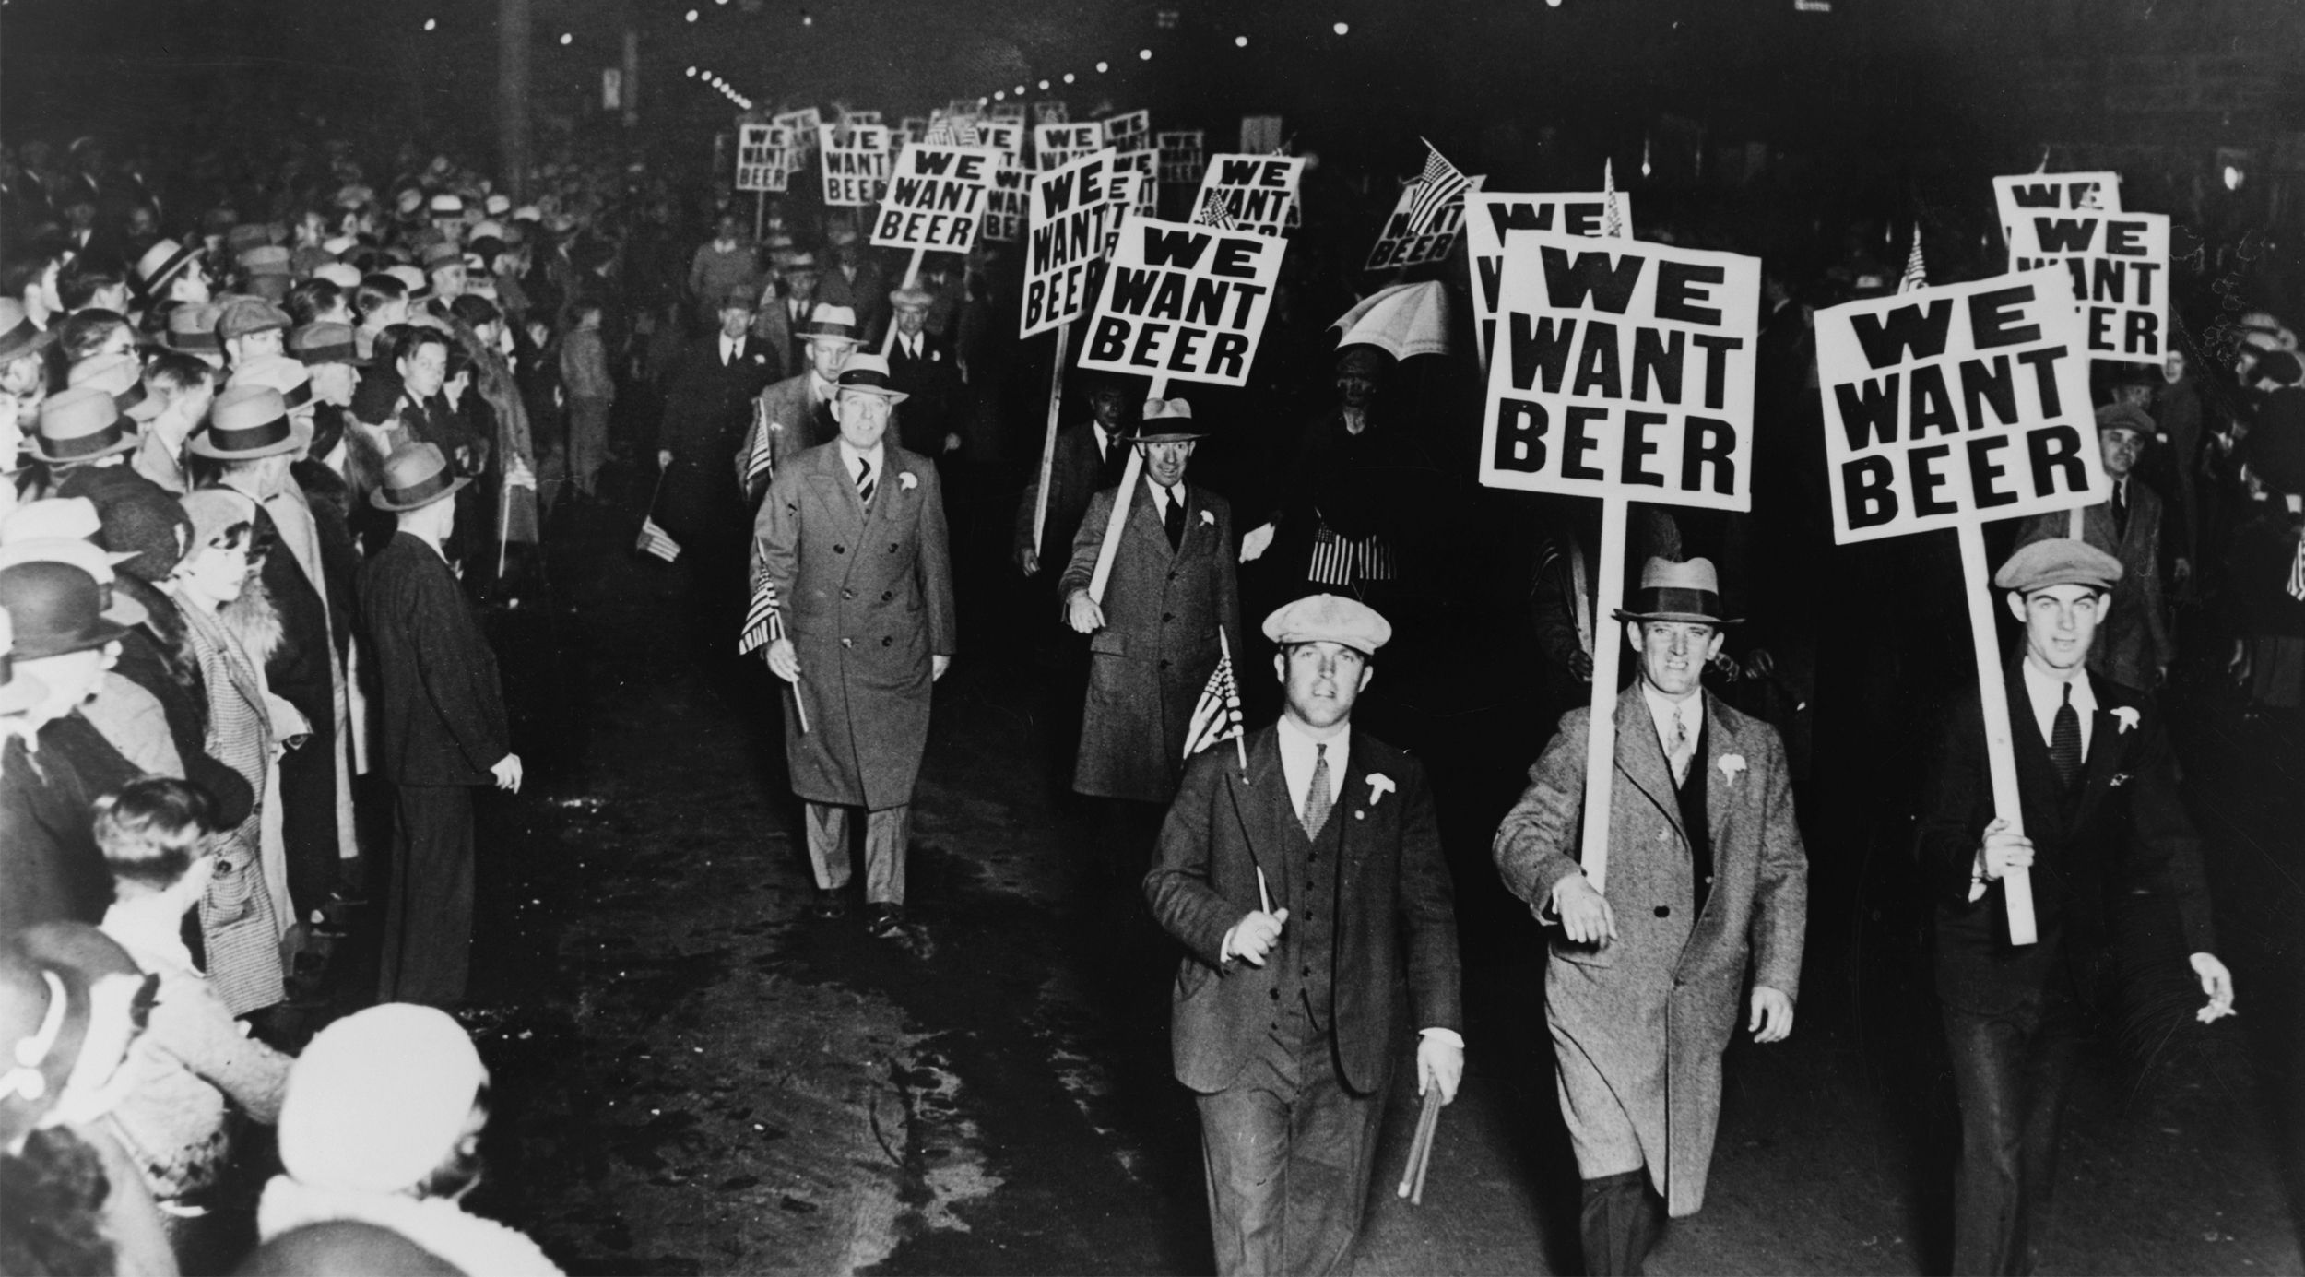
Creative Commons Licenses photos
Incorrect problem framing:
Prohibition in the US (1920-1933)
Government framing: “How can we eliminate the negative effects of alcohol on society, such as crime, poverty, and health issues?
18th amendment/Volstead Act banned alcohol
Bootlegging, organized crime
Hindsight reframing: “How can we reduce the harmful effects of alcohol on society through education, regulation, and addressing the social factors that contribute to addiction?”
Developed by Brielle Thompson
Notes:
But we all know this failed to address cultural and social issues. Leading to the rise of bootlegging, leading to mafias and mobs in the US

Slide 11

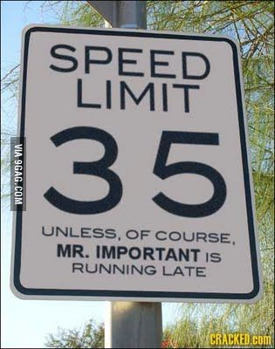
Creative Commons Licenses photos
Incorrect problem framing:
Speed Limits in the 1970s
Government framing: “How can we change the speed limit in the US to minimize fatalities?”
Debates on speed limit levels
Hindsight reframing: “What are ways that we can minimize car accident fatalities?”
Here we are thinking beyond speed limits
Developed by Brielle Thompson
Notes:
But we all know this failed to address cultural and social issues. Leading to the rise of bootlegging, leading to mafias and mobs in the US

Slide 12
Incorrect problem framing in natural resources
“We need to find ways to maximize fish harvests from this lake every year?”
Poorly framed because: overlooks population dynamics, breeding cycles, etc.
“What is the cheapest way to dispose mining waste?”
Poorly framed because: Only considers cost and does not mention environmental/human health concerns
“How can we extract as much groundwater as possible to support agricultural expansion?”
Poorly framed because: Does not think about long-term water availability and ecosystem needs
“How can we eliminate all invasive species from this ecosystem immediately?
Poorly framed because: Ignores ecological complexity, overlooks social/economic factors
Developed by Brielle Thompson

Slide 13
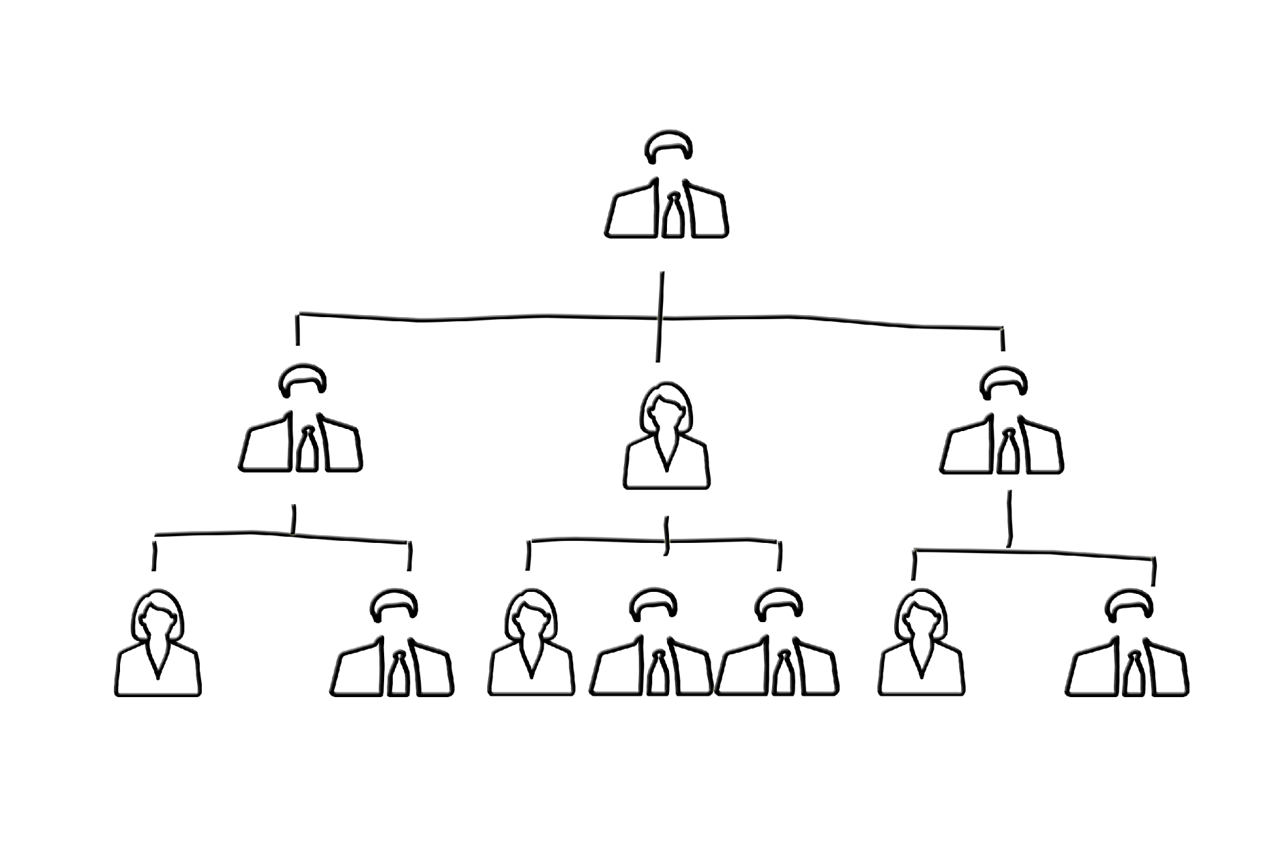
1. ID the decision maker(s)
Elements of problem framing:
Creative Commons Licenses photos
Who has the authority to commit to action?
Can be surprisingly difficult/complex!
Some scenarios
Single decision-maker
Multiple decision-makers
Willing to work together for joint aims
Competing with each other (not SDM)
Delegated authority
E.g., Governor → Director→ Administrator
Failure to ID & include all DMs in the process will make things difficult and confusing
Developed by Justin Gude, Angela Romito, Mike Runge

Slide 14

2. ID other key players
Elements of problem framing:
Creative Commons Licenses photos
Decision Implementers
Stakeholders/
interest groups
The public
Technical advisors
Interest group analysis
Who has the ability to influence the decision?
Who is influenced by the decision?
Developed by Justin Gude, Angela Romito, Mike Runge

Slide 15
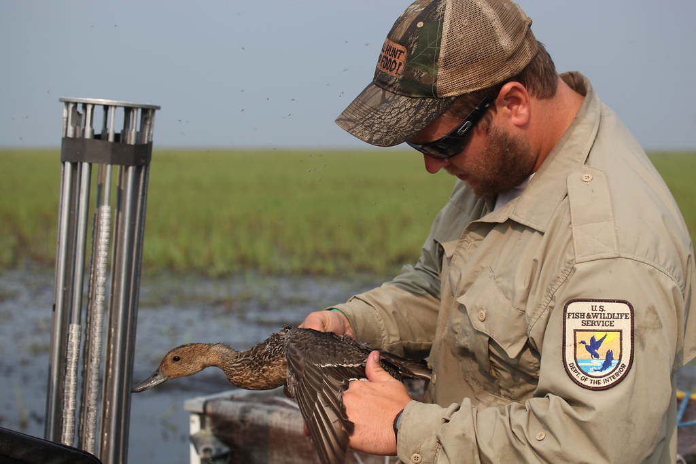
3. Consider the legal and regulatory context
Elements of problem framing:
Creative Commons Licenses photos
Particularly for decisions by public agencies
What laws confer authority for the decision?
How does the legislation or associated regulations bound the decision problems?
Example: USFWS is the decision maker and must follow Migratory Bird Treaty Act regulations
Developed by Justin Gude, Angela Romito, Mike Runge
Notes:
At a local scale, decision maker may be the aquaculture producer, State fish and wildlife agency, USDA Wildlife Services, or Tribe, etc. with objectives to protect fishing interests, co-nesting species or vegetation. At the National scale, decision maker may be USFWS which is mandated by Migratory bird treaty act to protect sustainable populations of migratory bird species.

Slide 16
Activity – who is the decision maker?
Scenario 1:
A local conservation group wants to restore a wetland to improve habitat for migratory birds. However, the land is privately owned, and the owner is considering selling it to a developer. The state wildlife agency has expressed interest in supporting restoration efforts.
Scenario 2:
A regional Forest Service office is planning prescribed burns to reduce wildfire risk. Residents are concerned about smoke and safety. Tribal representatives have requested consultation due to cultural sites in the area.
Scenario 3:
A multi-state fisheries commission is setting harvest quotas for a shared fishery. Each state has different priorities: some want higher quotas for economic reasons, others prioritize conservation. Tribal nations also have treaty rights to fish in the area.
In groups identify for each scenario:
Who is the actual decision maker in this situation?
What authority do they have to commit to action?
Developed by Brielle Thompson
Notes:
The private landowner is the primary decision maker—they control the land and can choose to sell or restore. The conservation group and state agency are stakeholders or influencers, but not decision makers unless they acquire the land or negotiate a binding agreement.
The Forest Service regional office is the formal decision maker, as they have the authority to implement fire management. However, they must operate within legal constraints (e.g., NEPA, tribal consultation) and consider stakeholder input, making the decision structure more complex.
The multi-state commission is the collective decision maker, but authority is shared among member states and constrained by tribal treaty rights. This makes problem framing more difficult, as objectives and constraints vary across jurisdictions.

Slide 17






4. Consider the decision structure
Elements of problem framing:
Creative Commons Licenses photos
Frequency & Timing - How often? When? Are other decisions linked?
Scope - How large, broad, complicated is the decision?
Objectives –What are the desired outcomes?
Actions – What kinds of alternatives are being chosen from?
Constraints - Legal, financial, political, perceived or real constraints?
Uncertainty - What degree of uncertainty is present? Can it be ignored?
Developed by Justin Gude, Angela Romito, Mike Runge

Slide 18


5. Consider the type of analysis required
Elements of problem framing:
How much detail is needed?
Do the data and analytical methods exist?
Do you have access to the expertise?
Is uncertainty an impediment?
What “class” of decision problem do you have
Developed by Justin Gude, Angela Romito, Mike Runge
Notes:
To choose among alternatives, what analysis will be required?

Slide 19

Decision problem classes:
Certain decision structures appear again and again.
Being able to recognize these classes of decision problems helps structure the problem and identify analytical tools.
“Classifying a decision problem can be like trying to find a skeleton in a jellyfish”
- Mike Runge
Developed by Justin Gude, Angela Romito, Mike Runge
Notes:
What does this quote mean:
Lack of Clear Structure: Just as a jellyfish lacks a rigid skeleton, some decision problems lack a clear, well-defined framework. They may be fluid, messy, and hard to pin down.
Complex and Soft Boundaries: The boundaries of the problem may be fuzzy, with overlapping issues, stakeholders, and objectives that resist neat categorization.
Hidden or Nonexistent Elements: You might be searching for a logical structure or classification system that simply isn’t there—or isn’t visible without deeper analysis.
Frustration in Problem Definition: It suggests that trying to classify such problems can feel futile or confusing, especially when traditional decision-making tools don’t seem to apply.

Slide 20
6 decision problem classes:
1) Prediction Problems – impediment is ability to predict achievement of objective
2) Multiple Objective Problems – impediment is how to trade-off competing objectives
3) Portfolio Problems – impediment is having to search among a very large selection of alternatives
4) Risk Problems – must make decisions in the face of uncertainty
5) Information Problems – impediment is determining value of reducing uncertainty before decision making
6) Dynamic Problems – impediment is balancing short-term costs with long-term benefits
These are not really mutually exclusive… Most natural resource problems have elements of each of these. It’s a matter of thinking how best to structure a problem and which tools are therefore most appropriate to use.
Developed by Justin Gude, Angela Romito, Mike Runge
Notes:
To choose among alternatives, what analysis will be required?

Slide 21
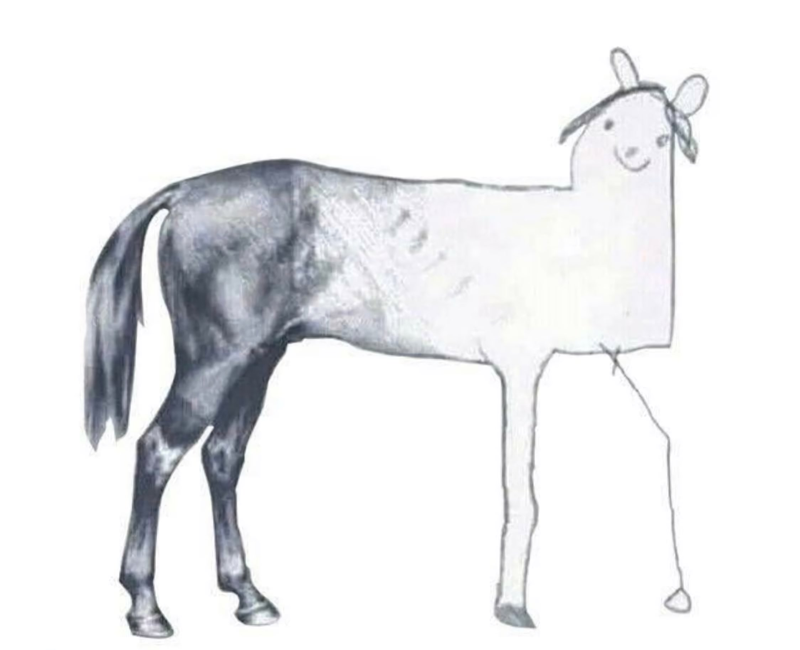
6. Revise as needed
Elements of problem framing:
First prototype
Final product
The problem statement is likely to change as development proceeds
Adopt iterative/ rapid prototyping as an approach
“Good enough for now, safe enough to try”
Developed by Justin Gude, Angela Romito, Mike Runge

Slide 22
Problem framing: problem statement
About a paragraph long (or sometimes a very long, run-on sentence)
Captures the essential outline of the problem
Helps participants focus
Limits objectives and alternatives to those relevant to the problem
Developed by Justin Gude, Angela Romito, Mike Runge

Slide 23

Problem framing: prompts
Decision Maker – Who will make the decision?
Trigger – Why does a decision need to be made? Why does it matter?
Action – What is the decision? What action needs to be taken?
Constraints – legal, financial, political? Are these perceived or real?
Frequency and Timing – Periodicity of decision. Are other decisions linked to this one?
Scope – How broad or complicated is the decision?
Developed by Justin Gude, Angela Romito, Mike Runge

Slide 24
Example:
[1] What is the decision—what kind of action needs to be taken?
[2] What triggered this decision; why does it matter?
[3] What are the legal context and constraints?
[4] Who is the decision maker?
[5] What is the decision timing and frequency; are other decisions linked?
[6] What is the scope of the problem (how broad or complicated is it)?
Jean Fitts Cochrane, Angela Matz, Mitch Eaton –SDM workshop
[1] A revised program of vegetation treatment needs to be implemented for Rolling Thunder NWR that achieves recovery goals for protected prairie-endemic species. [2] Recently, refuge conservation objectives expanded to include sustaining newly listed butterfly and beetle populations. These species may be harmed by some grassland management practices, particularly prescribed burning that has been used for 25 years to control woody species invasion and benefit rare plant populations. [3] The new program will become part of a multi-species recovery plan to meet ESA requirements, and will also have to comply with the NWR Administration Act and NEPA. Management options may be constrained by nearby residential development and local opposition to prescribed fires; also local ranchers expect economic benefits from grazing cattle on the refuge. [4] The refuge manager must decide on a treatment program, in consultation with the species recovery team. [5] The program must be in place by the summer and will last for five years. Some of the treatments may restrict future management options for up to 10 years, because of infrastructure commitments and ecological effects. [6] While the vegetation management strategy technically only applies to grasslands on about half of this refuge for a five-year program, the decision is considered critical for sustaining these endemic prairie species throughout their limited ranges
Developed Brielle K Thompson

Slide 25
Decision Statement – Example
2014 Mountain Lion Hunting Season
The MT Fish and Wildlife Commission is in the process of establishing the mountain lion harvest quotas and permit numbers for 2014 in MFWP Region 2. There is no mountain lion management plan to guide the decision. There is uncertainty regarding current lion population density estimates; harvest levels, and sex and age structure of the harvest that are needed to achieve the desired outcomes; and the impact of lion predation on ungulate population dynamics, especially in areas where ungulate populations are in serious decline and recruitment levels leave populations in jeopardy. The differing expectations of lion hunters and deer/elk hunters regarding lion population density and demographic structure of the lion population are in conflict. There is also disagreement regarding the allocation of the lion harvest between residents and nonresidents, and the impact of season structure options on local businesses—as well as how the various season structure options impact lion hunt quality and public perceptions of hunter ethics.
Developed by Justin Gude

Slide 26
Decision Statement – Example
2014 Mountain Lion Hunting Season: Decision Maker
The MT Fish and Wildlife Commission is in the process of establishing the mountain lion harvest quotas and permit numbers for 2014 in MFWP Region 2. There is no mountain lion management plan to guide the decision. There is uncertainty regarding current lion population density estimates; harvest levels, and sex and age structure of the harvest that are needed to achieve the desired outcomes; and the impact of lion predation on ungulate population dynamics, especially in areas where ungulate populations are in serious decline and recruitment levels leave populations in jeopardy. The differing expectations of lion hunters and deer/elk hunters regarding lion population density and demographic structure of the lion population are in conflict. There is also disagreement regarding the allocation of the lion harvest between residents and nonresidents, and the impact of season structure options on local businesses—as well as how the various season structure options impact lion hunt quality and public perceptions of hunter ethics.
Developed by Justin Gude

Slide 27
Decision Statement – Example
2014 Mountain Lion Hunting Season: Action
The MT Fish and Wildlife Commission is in the process of establishing the mountain lion harvest quotas and permit numbers for 2014 in MFWP Region 2. There is no mountain lion management plan to guide the decision. There is uncertainty regarding current lion population density estimates; harvest levels, and sex and age structure of the harvest that are needed to achieve the desired outcomes; and the impact of lion predation on ungulate population dynamics, especially in areas where ungulate populations are in serious decline and recruitment levels leave populations in jeopardy. The differing expectations of lion hunters and deer/elk hunters regarding lion population density and demographic structure of the lion population are in conflict. There is also disagreement regarding the allocation of the lion harvest between residents and nonresidents, and the impact of season structure options on local businesses—as well as how the various season structure options impact lion hunt quality and public perceptions of hunter ethics.
Developed by Justin Gude

Slide 28
Decision Statement – Example
2014 Mountain Lion Hunting Season: Temporal extent
The MT Fish and Wildlife Commission is in the process of establishing the mountain lion harvest quotas and permit numbers for 2014 in MFWP Region 2. There is no mountain lion management plan to guide the decision. There is uncertainty regarding current lion population density estimates; harvest levels, and sex and age structure of the harvest that are needed to achieve the desired outcomes; and the impact of lion predation on ungulate population dynamics, especially in areas where ungulate populations are in serious decline and recruitment levels leave populations in jeopardy. The differing expectations of lion hunters and deer/elk hunters regarding lion population density and demographic structure of the lion population are in conflict. There is also disagreement regarding the allocation of the lion harvest between residents and nonresidents, and the impact of season structure options on local businesses—as well as how the various season structure options impact lion hunt quality and public perceptions of hunter ethics.
Developed by Justin Gude

Slide 29
Decision Statement – Example
2014 Mountain Lion Hunting Season: Spatial extent
The MT Fish and Wildlife Commission is in the process of establishing the mountain lion harvest quotas and permit numbers for 2014 in MFWP Region 2. There is no mountain lion management plan to guide the decision. There is uncertainty regarding current lion population density estimates; harvest levels, and sex and age structure of the harvest that are needed to achieve the desired outcomes; and the impact of lion predation on ungulate population dynamics, especially in areas where ungulate populations are in serious decline and recruitment levels leave populations in jeopardy. The differing expectations of lion hunters and deer/elk hunters regarding lion population density and demographic structure of the lion population are in conflict. There is also disagreement regarding the allocation of the lion harvest between residents and nonresidents, and the impact of season structure options on local businesses—as well as how the various season structure options impact lion hunt quality and public perceptions of hunter ethics.
Developed by Justin Gude

Slide 30
Decision Statement – Example
2014 Mountain Lion Hunting Season: Consider conflict
The MT Fish and Wildlife Commission is in the process of establishing the mountain lion harvest quotas and permit numbers for 2014 in MFWP Region 2. There is no mountain lion management plan to guide the decision. There is uncertainty regarding current lion population density estimates; harvest levels, and sex and age structure of the harvest that are needed to achieve the desired outcomes; and the impact of lion predation on ungulate population dynamics, especially in areas where ungulate populations are in serious decline and recruitment levels leave populations in jeopardy. The differing expectations of lion hunters and deer/elk hunters regarding lion population density and demographic structure of the lion population are in conflict. There is also disagreement regarding the allocation of the lion harvest between residents and nonresidents, and the impact of season structure options on local businesses—as well as how the various season structure options impact lion hunt quality and public perceptions of hunter ethics.
Developed by Justin Gude

Slide 31
Decision Statement – Example
2014 Mountain Lion Hunting Season: Consider uncertainty
The MT Fish and Wildlife Commission is in the process of establishing the mountain lion harvest quotas and permit numbers for 2014 in MFWP Region 2. There is no mountain lion management plan to guide the decision. There is uncertainty regarding current lion population density estimates; harvest levels, and sex and age structure of the harvest that are needed to achieve the desired outcomes; and the impact of lion predation on ungulate population dynamics, especially in areas where ungulate populations are in serious decline and recruitment levels leave populations in jeopardy. The differing expectations of lion hunters and deer/elk hunters regarding lion population density and demographic structure of the lion population are in conflict. There is also disagreement regarding the allocation of the lion harvest between residents and nonresidents, and the impact of season structure options on local businesses—as well as how the various season structure options impact lion hunt quality and public perceptions of hunter ethics.
Developed by Justin Gude

Slide 32
The equation for problem framing
Using the following template:
“Decision Maker (D) is trying to do X to achieve Y over time Z and in place W considering B.”
where,
D = the Decision maker(s)
X = the type(s) of action that needs to be taken
Y = the ultimate goal(s) to be achieved by “X”
Z = the temporal extent of the decision problem.
W = the spatial extent of the decision problem
B = potential constraints (legal, financial, and political)
and important uncertainties (scientific or other)
Developed by Justin Gude, Angela Romito, Mike Runge

Slide 33
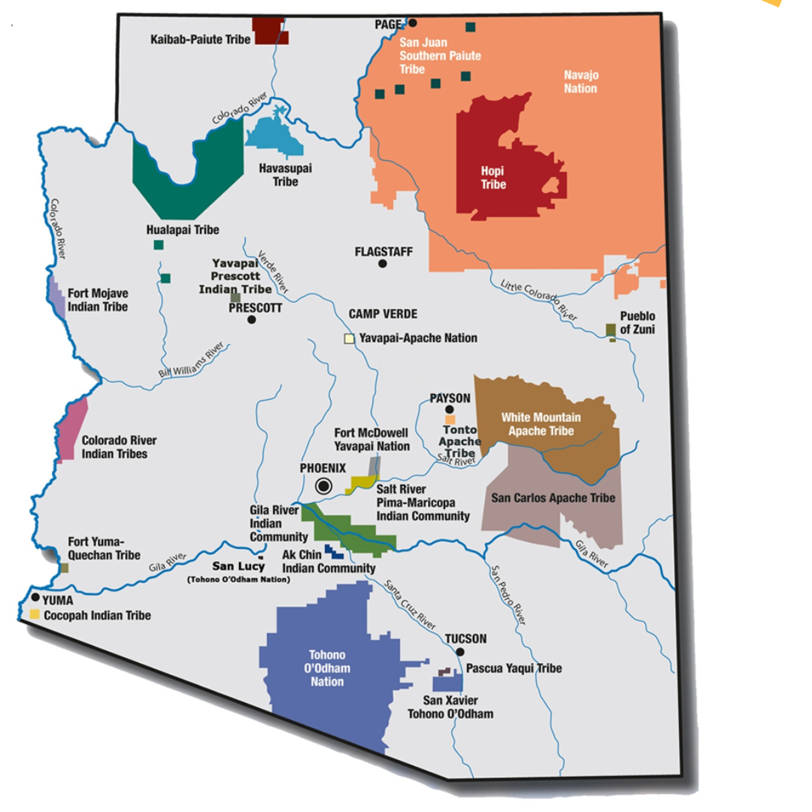
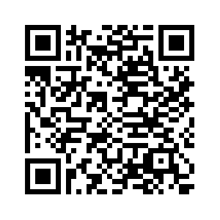
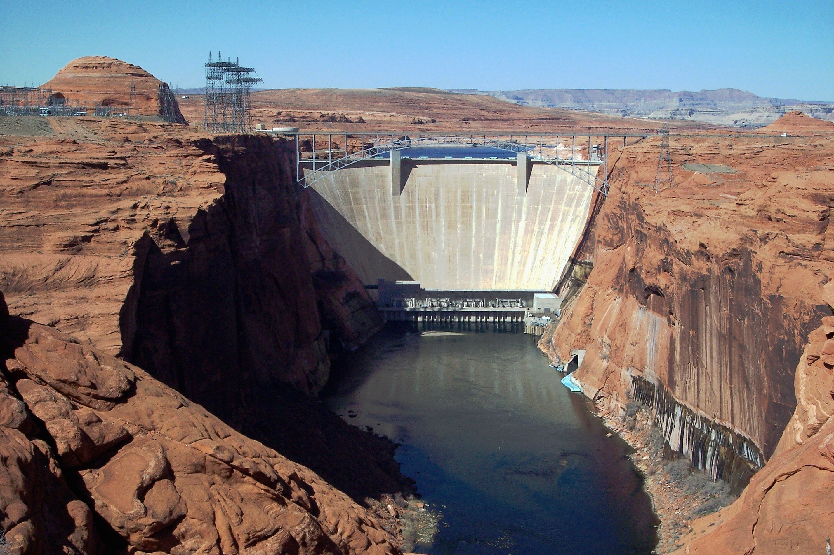
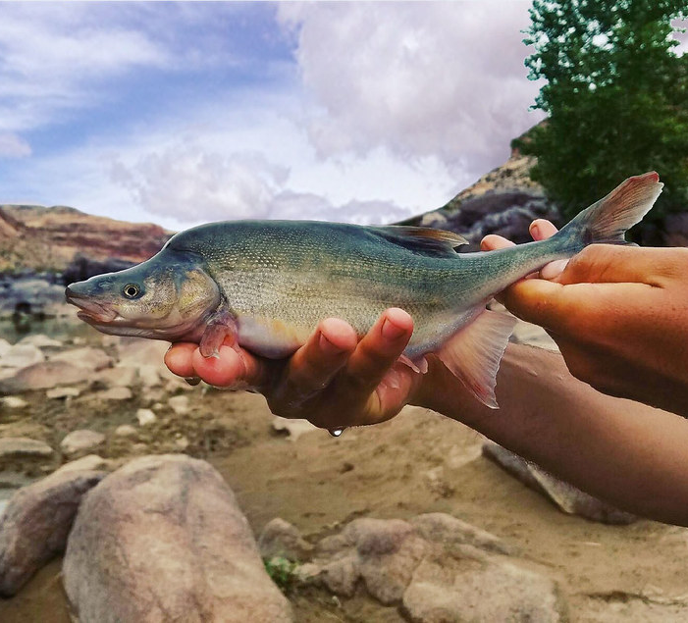
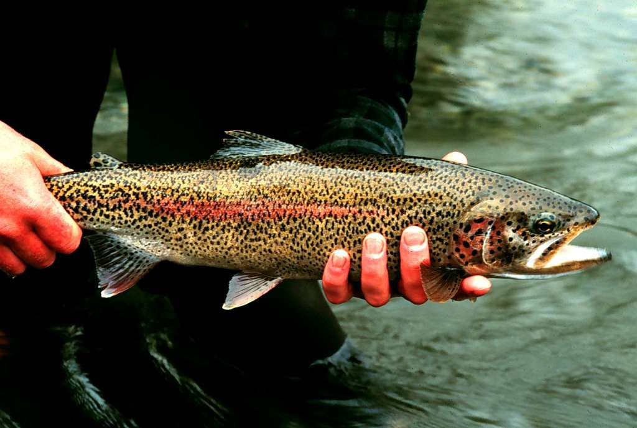
Example: (Runge et al. 2011)
Creative Commons Licenses photos
Arizona Department of Education
“Decision Maker (D) is trying to do X to achieve Y over time Z and in place W considering B.”
Brief problem statement:
Bureau of reclamation is trying to make decisions regarding invasive trout management to achieve recovery of humpback chub populations over the next 5 years in the Little Colorado River, below the Glen Canyon Dam considering sacred sites and spiritual values of local Native American tribes (e.g., avoid taking of life), humpback chub recovery, trout invasion, recreational values, cost, and local economies.
Adapted, modified, and simplified from Runge et al. 2011
Notes:
https://pubs.usgs.gov/of/2011/1012/pdf/ofr20111012.pdf#page=17.21

Slide 34
Skills check 1 (30 minutes)
I will provide you with details for a real-life natural resource management decision and using this information, you will:
Answer the following:
What is the decision—what kind of action needs to be taken?
What triggered this decision?
What are the legal context and constraints?
Who is the decision maker?
What is the decision timing and frequency; are other decisions linked to this one?
What is the scope of the problem (how broad or complicated is it)?
What makes this decision hard (what is the primary impediment to the decision)?
Then make your own problem statement
Then I will give you the published problem statement and you will
Compare your statement with the published statement
Developed by Brielle Thompson

Slide 35
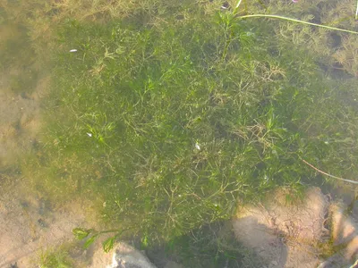
Group 1:
Creative Commons Licenses photos
What did you learn?
How did your statement compare with the published statement?
What more information would you have wanted to have?
Is this process useful for natural resource managers?
Case Study: Sepulveda, Adam J., Christine E. Dumoulin, Denise L. Blanchette, John McPhedran, Colin Holme, Nathan Whalen, Margaret E. Hunter et al. "When are environmental DNA early detections of invasive species actionable?." Journal of Environmental Management 343 (2023): 118216.

Slide 36
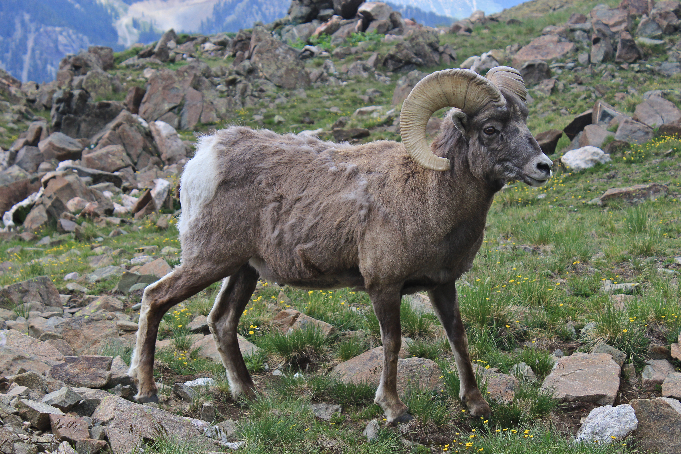
Group 2:
Creative Commons Licenses photos
What did you learn?
How did your statement compare with the published statement?
What more information would you have wanted to have?
Is this process useful for natural resource managers?
Case Study: Sells, S.N., Mitchell, M.S., Edwards, V.L., Gude, J.A. and Anderson, N.J., 2016. Structured decision making for managing pneumonia epizootics in bighorn sheep. The Journal of Wildlife Management, 80(6), pp.957-969.

Slide 37
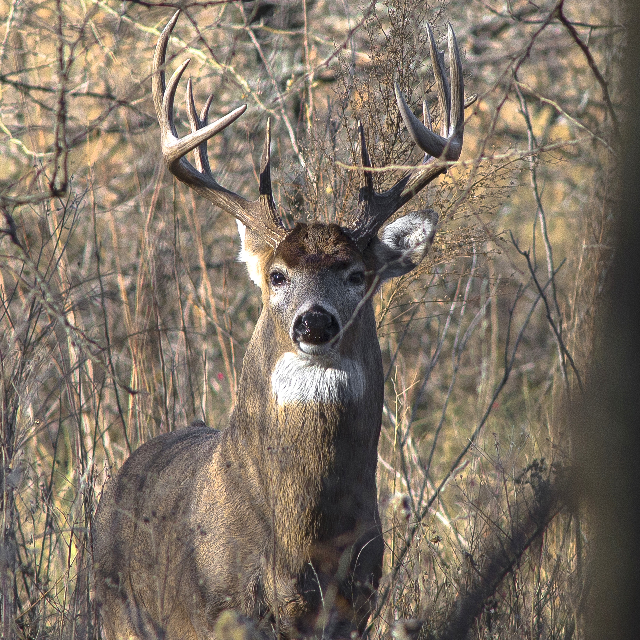
Group 3:
Creative Commons Licenses photos
What did you learn?
How did your statement compare with the published statement?
What more information would you have wanted to have?
Is this process useful for natural resource managers?
Case Study: Robinson, K.F., Fuller, A.K., Hurst, J.E., Swift, B.L., Kirsch, A., Farquhar, J., Decker, D.J. and Siemer, W.F., 2016. Structured decision making as a framework for large‐scale wildlife harvest management decisions. Ecosphere, 7(12), p.e01613.

Slide 38
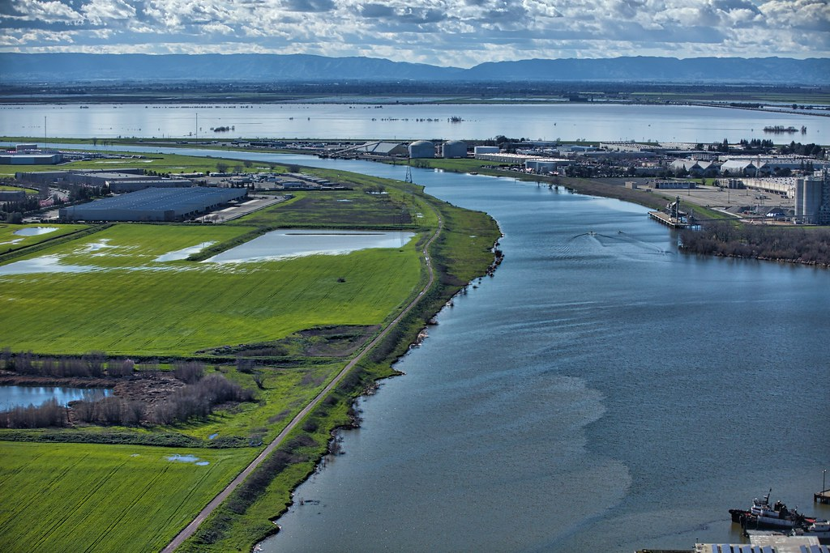
Group 4:
Creative Commons Licenses photos
What did you learn?
How did your statement compare with the published statement?
What more information would you have wanted to have?
Is this process useful for natural resource managers?
Case Study: Peterson, J.T., McCreless, E., Duarte, A., Wohner, P., Hamilton, S., Medellín-Azuara, J. and Escriva-Bou, A., 2024. Prototyping structured decision making for water resource management in the San Francisco Bay-Delta. Environmental Science & Policy, 157, p.103775

Slide 39
Activity: think about your decision problem
For your final project presentation, you will provide a slide of your problem framing statement
Individually think about your problem and start jotting down elements of your problem statement (see skill check for prompts)
With a partner discuss your final project SDM prototype and the Problem framing step
Developed by Brielle Thompson

Slide 40
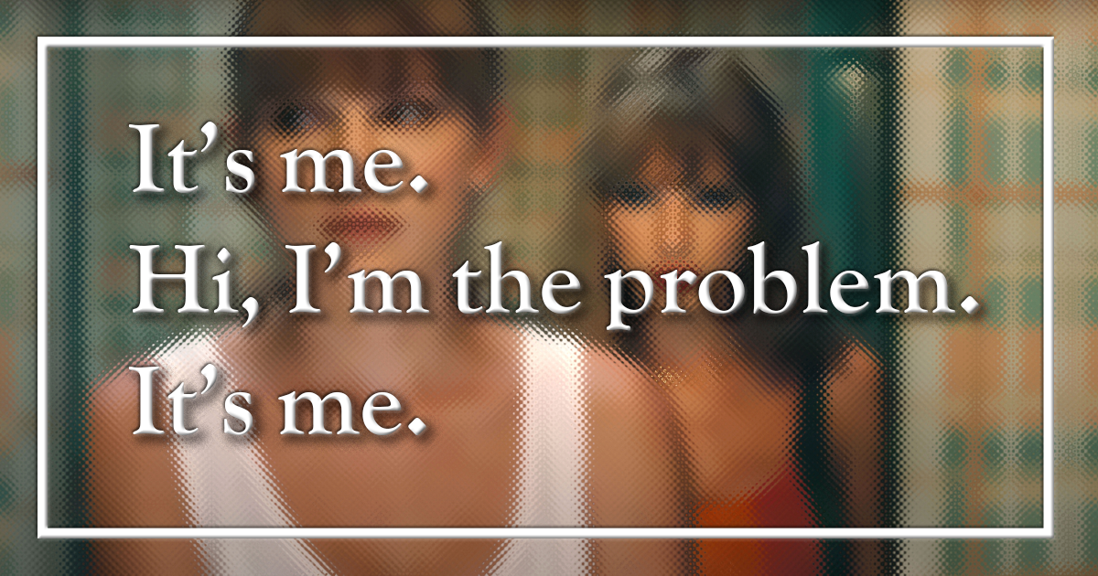
Avoid Common Pitfalls
“Frame Blindness”
Are there other perspectives that aren’t being considered?
Are any perceived constraints imaginary?
Are we biased by earlier actions, successes, or failures?
Are we making any false assumptions?
Are we solving the right problem and is our scope correct?
WHAT’S THE PROBLEM?
(warning some adult language)
https://www.youtube.com/watch?v=HiB9L3dG-Aw
Developed by Justin Gude, Angela Romito, Mike Runge, Brielle Thompson
Notes:
Play video about problem framing. Not uncommon to have everyone think they know what a problem is, then when you ask them to say it loud they all have different ideas. E.g. lion season-setting discussion at FWP training.
Moneyball clip is also a good example of a problem looking different at different org chart levels. Elements of truth to both ways of thinking. Also brings up the importance of leadership style & plans- do you want people to follow or get out of the way? What happens in Moneyball?

Slide 41

Discussion:
Why is the problem framing step useful?
Developed by Brielle Thompson

Slide 42
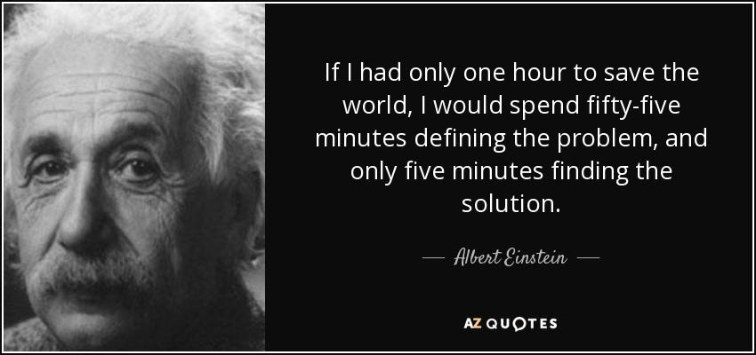
Problem framing is hard!
It’s worth taking the time to get it right…
Developed by Justin Gude, Angela Romito, Mike Runge

Slide 43
Looking ahead:
Next week: O step of PrOACT
Weekly: Work through a step of the PrOACT process/ learn extra tools
Last week of class:
Elevator pitch of your research project in terms of SDM/PrOACT
Note: Abridged PrOACT story slides with a star on the upper right are good examples to use for your presentation
Developed by Brielle Thompson

Slide 44

Extra time activities:

Slide 45
Activity: Identify how these poorly written problem statements can be improved
We need to get rid of all the invasive rats in Central Park as soon as possible because they’re bad for nature. This should be easy if we just remove them all at once. They don’t belong here and are ruining everything. We don’t need to worry about how or what happens after—they just need to go.
The forest in Coastal Oregon isn’t making money, so we should clear it and use the land for something more useful. It’s just sitting there and not helping the economy. If we replace it with farms or buildings, we’ll get more value.
We should allow more fishing in Lake of the Ozarks because people want to catch more fish, and it helps the local economy. Fish populations will probably bounce back anyway. Regulations are annoying and hurt business. Letting people fish freely is the best way to keep everyone happy.
Wolves in Montana are causing problems near farms, so we should remove them all from the area. They’re eating crops, killing livestock, and bothering people. Relocation or fencing might be too expensive, so just getting rid of them is easier. It’s not worth trying to balance wildlife and farming.
Developed by Brielle Thompson

Slide 46
Activity discussion (5 minutes)
Was it difficult to edit an existing problem statement?
How did you improve the statement?
How do you think changing the statement would affect the decision?
Aka: Is there a concern for an outside group to make the decision statement on behalf of the decision maker?
Developed by Brielle Thompson

Slide 47
Reading discussion
Chapter 2 Runge et al. 2020 (DM Smith)
What is meant by an “error of the third kind” in decision analysis, and why is it important to avoid it?
How can framing a decision narrowly versus broadly influence the range of possible solutions and stakeholder engagement?
In the horseshoe crab and red knot case study, how did different frames (narrow vs. broad) affect the management approach?
Why is identifying the decision maker considered a central challenge in decision structuring, especially in collaborative contexts?
How does prototyping contribute to refining decision structures, and what are the advantages of a “fail fast” approach?

